Slide 1

Collaborate in Power BI
Notes:
Photo by Mimi Thian on Unsplash

Slide 2
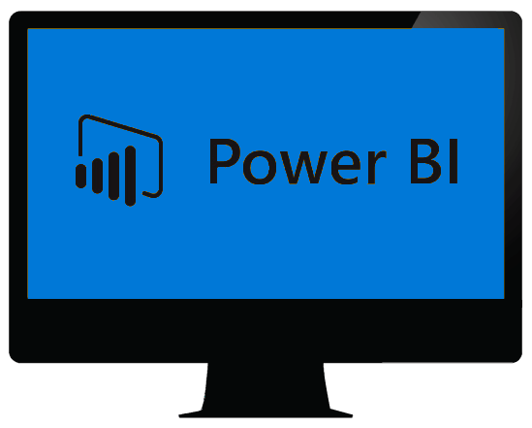
Power BI Desktop

Slide 3
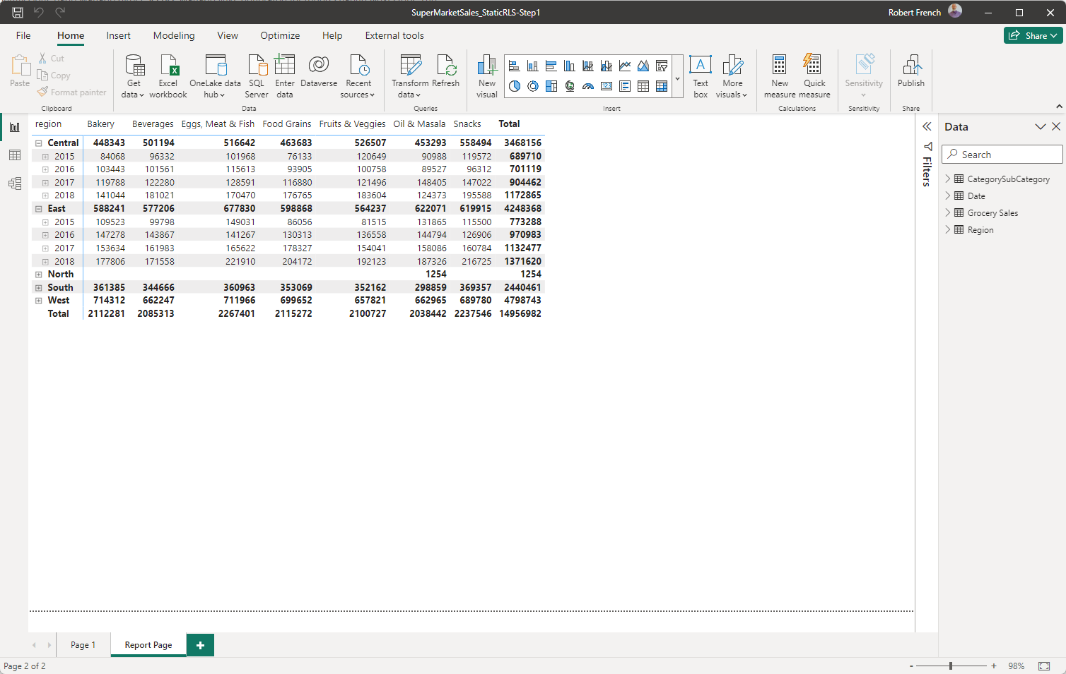

Slide 4
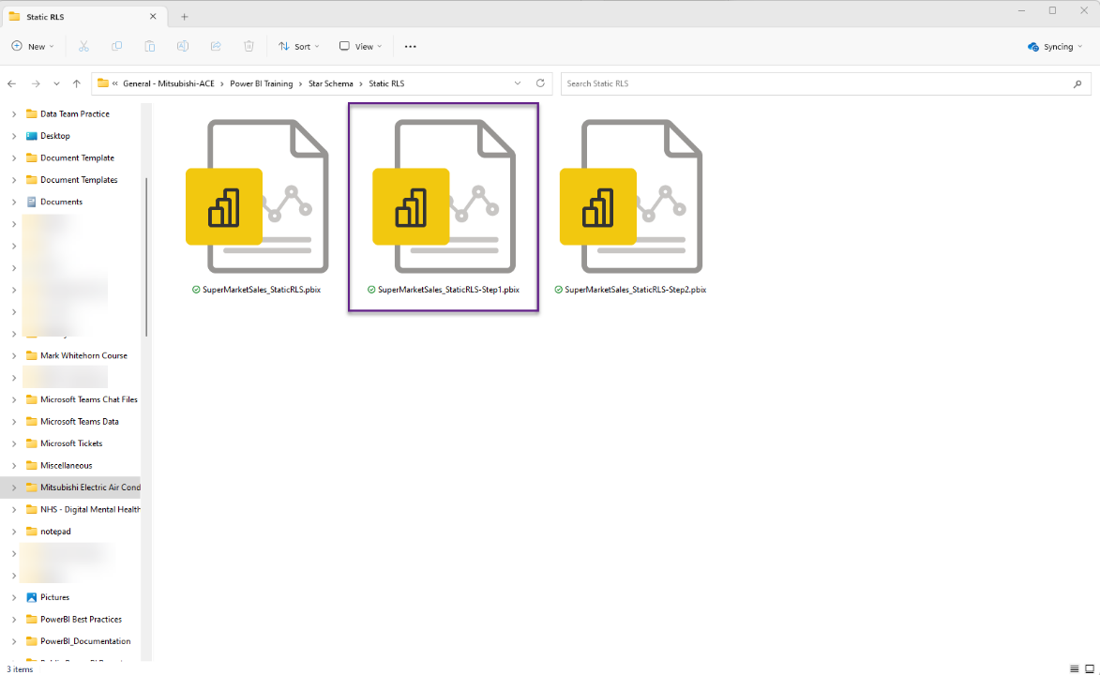

Slide 5

Notes:
Photo by Ben White on Unsplash
Can share desktop files for free with anyone who has the application

Slide 6

Notes:
Photo by Stephen Phillips - Hostreviews.co.uk on Unsplash

Slide 7

Notes:
Photo by Kelly Sikkema on Unsplash

Slide 8

This Photo by Unknown Author is licensed under CC BY-NC-ND

Slide 9
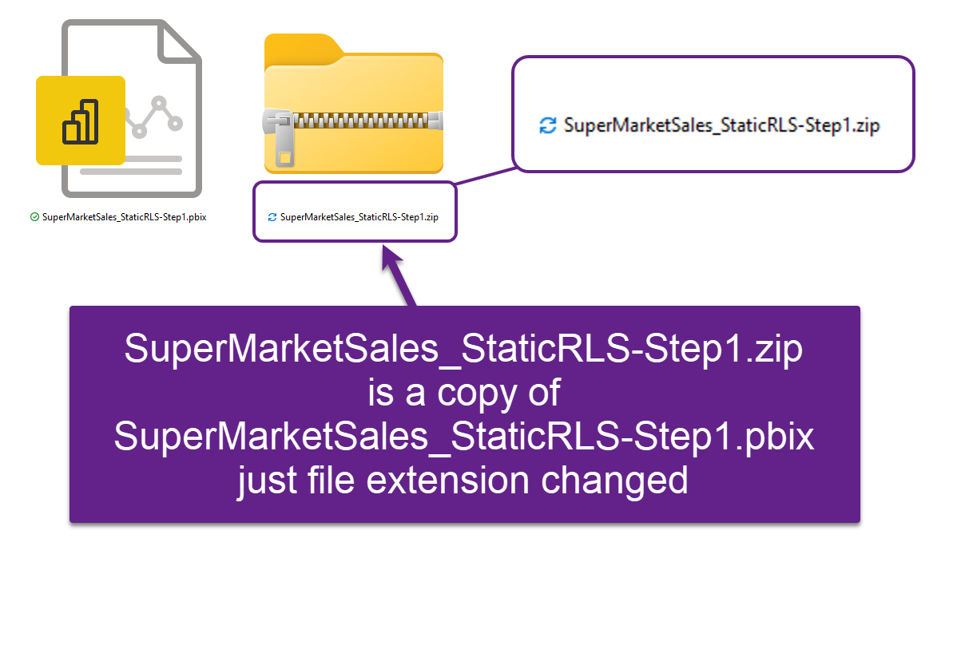

Slide 10
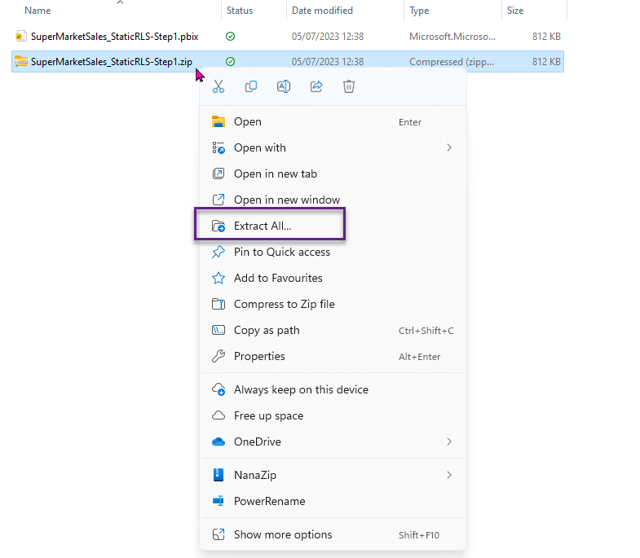

Slide 11
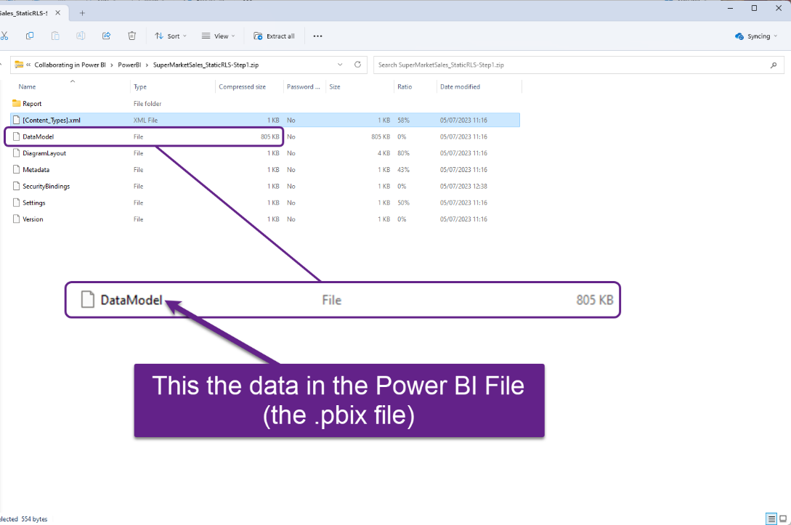

Slide 12


Notes:
If the Power BI report is within a one drive environment

Slide 13
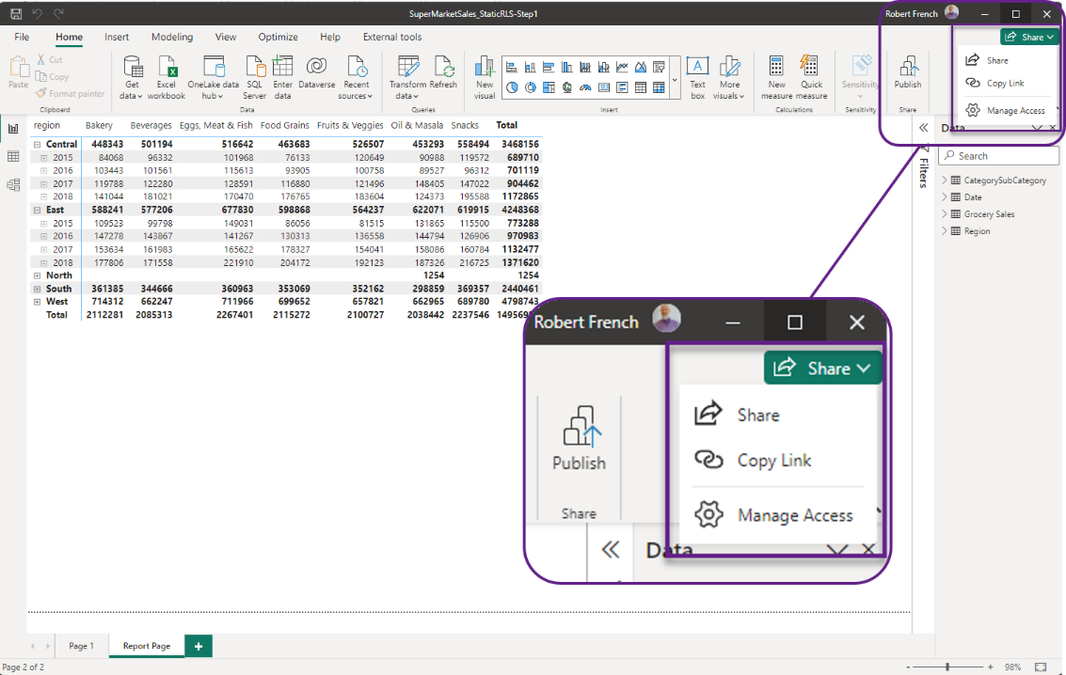

Slide 14
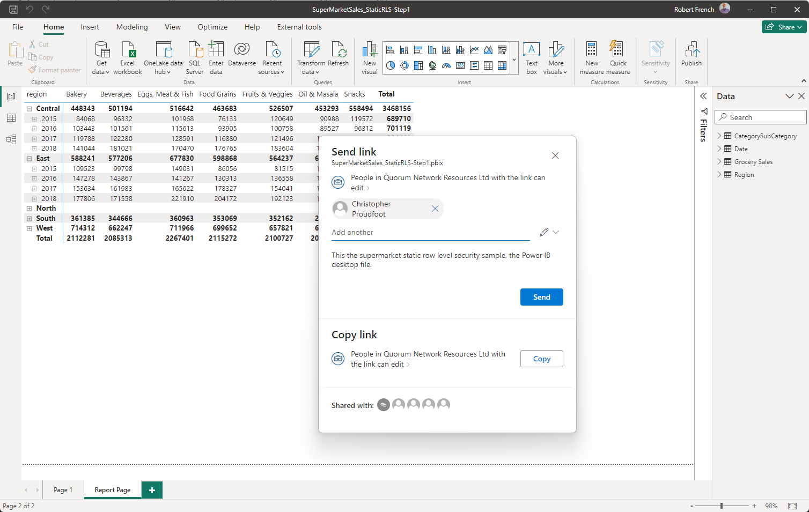

Slide 15


Slide 16
Advantages of storing in one drive
Version control
Access control
Security
Automated backup to the cloud
Disadvantages of storing in one drive
Version control - “the file has changed”
Only one person can access the file

Slide 17
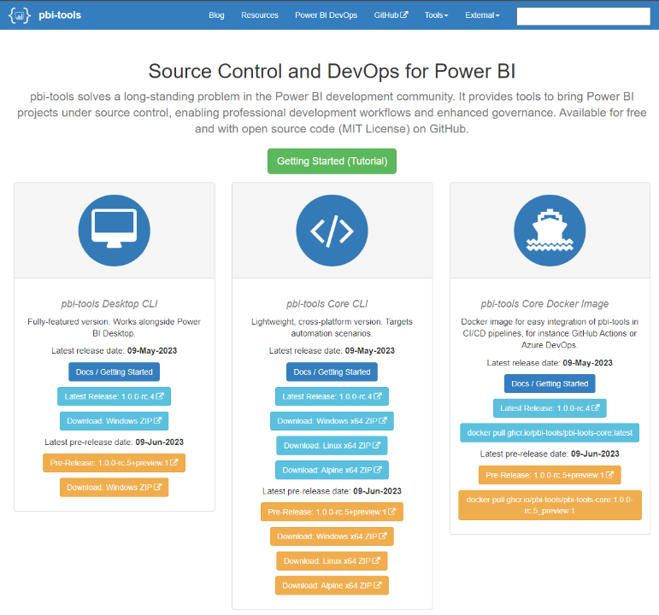
https://pbi.tools/

Slide 18

Notes:
Photo by Jeff Stapleton: https://www.pexels.com/photo/person-holding-a-cardboard-banner-with-what-now-written-on-it-5802888/

Slide 19
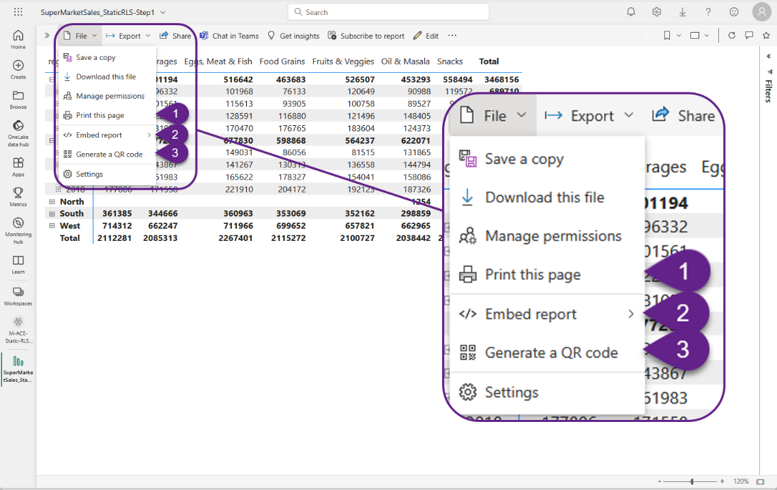

Slide 20


Notes:
Photo by Wendelin Jacober: https://www.pexels.com/photo/green-and-black-industrial-machine-1440504/

Slide 21
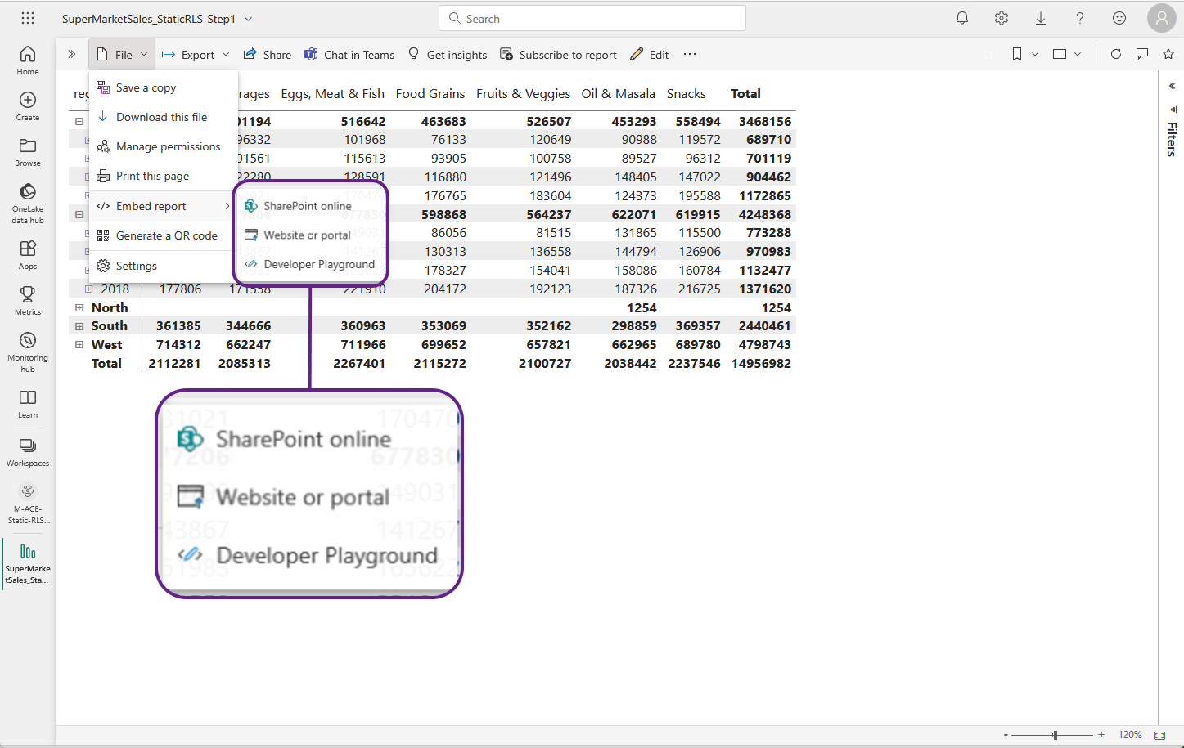

Slide 22
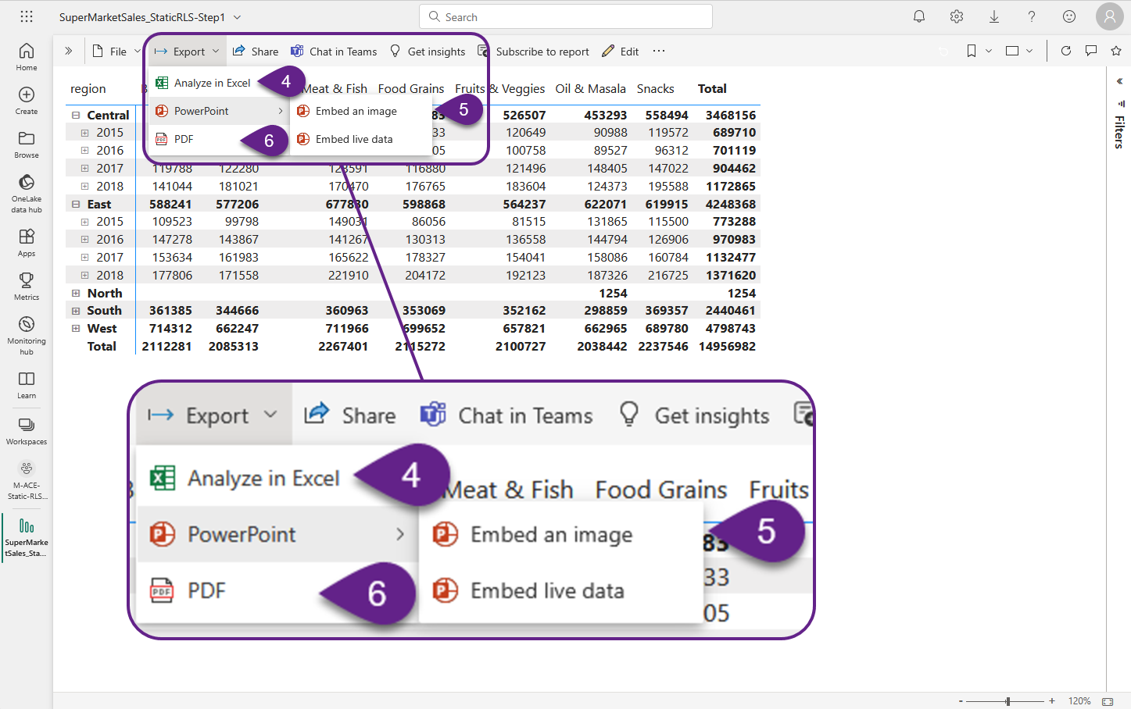

Slide 23
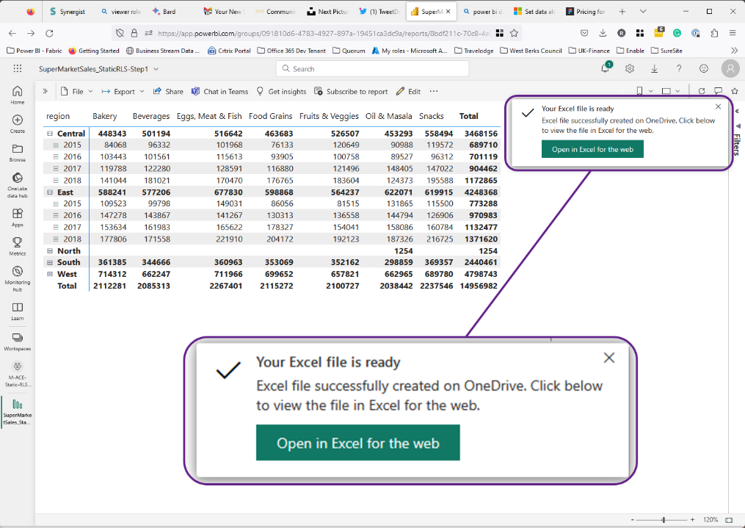

Slide 24
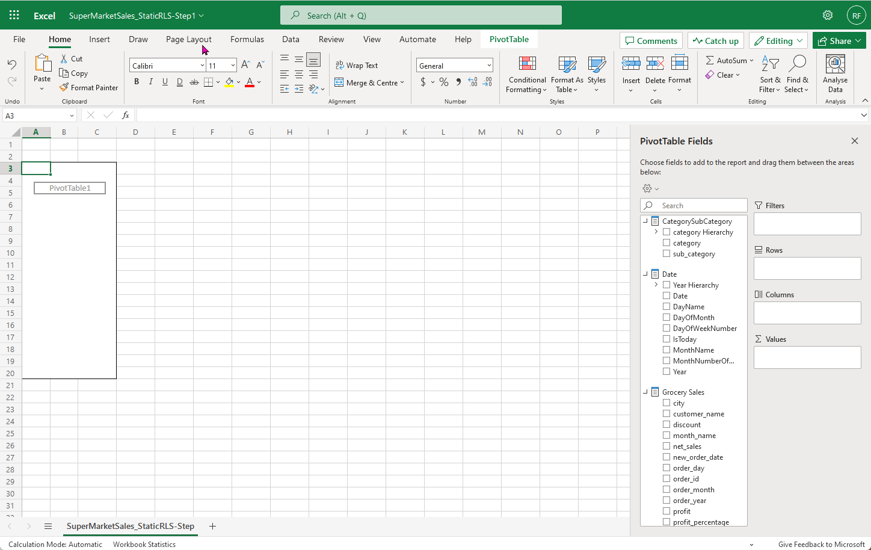

Slide 25
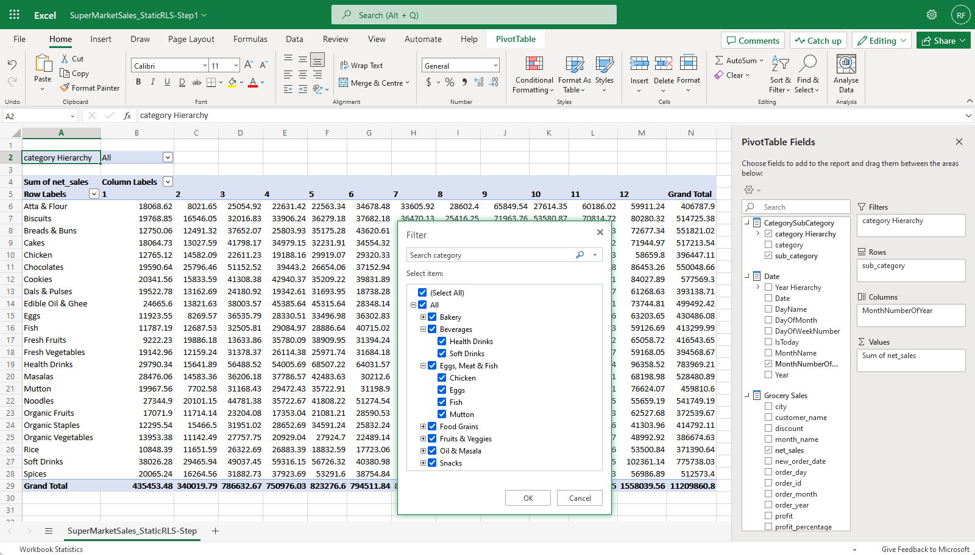

Slide 26
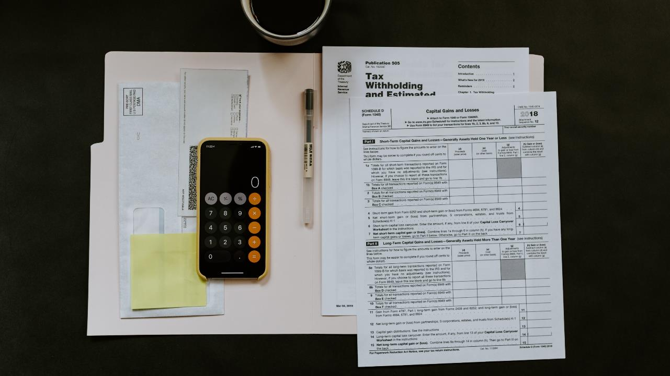
Notes:
Photo by Kelly Sikkema on Unsplash
What can I say people in finance love Excel

Slide 27

This Photo by Unknown Author is licensed under CC BY

Slide 28
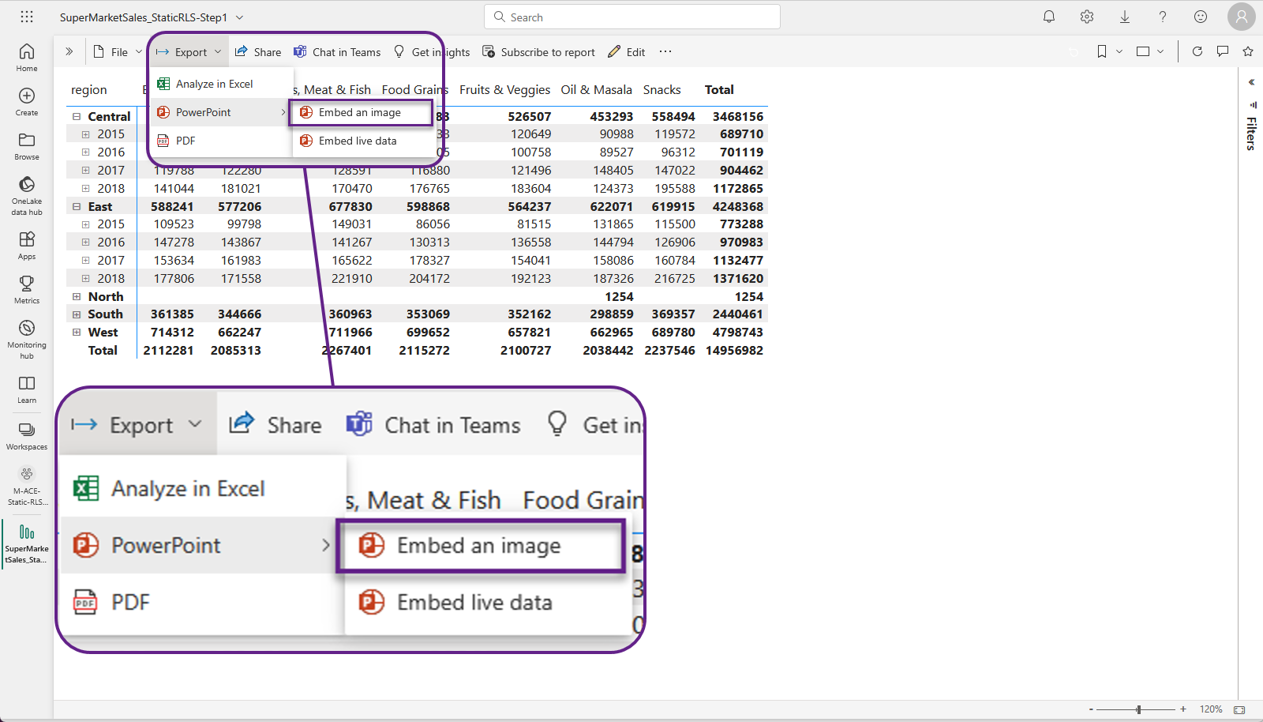

Slide 29
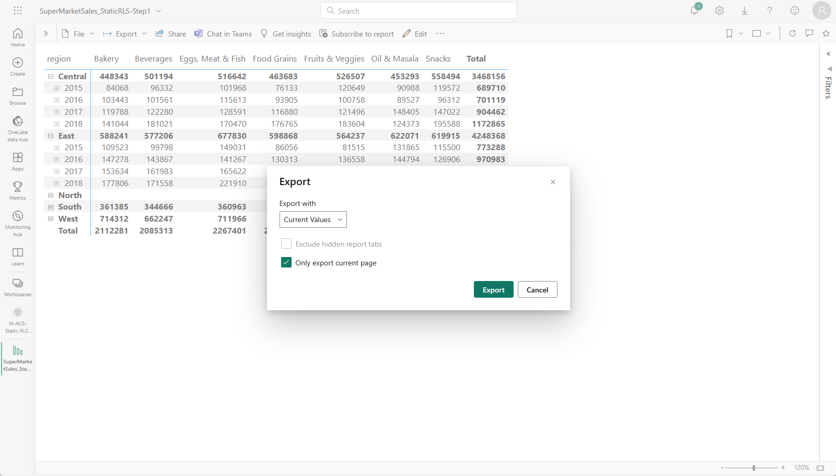

Slide 30

SuperMarketSales_StaticRLS-Step1
View in Power BI
Last data refresh:
05/07/2023 15:26:24 UTC
Downloaded at:
05/07/2023 16:45:05 UTC

Slide 31
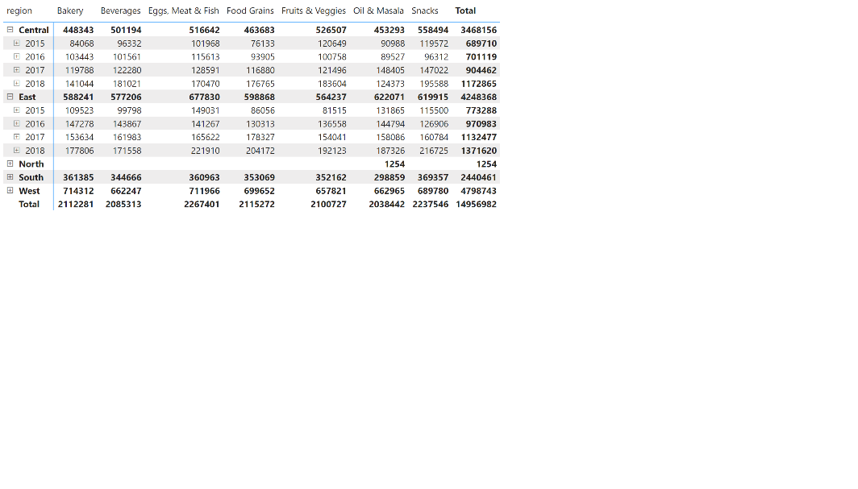
Report Page
Notes:
pivotTable
No alt text provided

Slide 32

This Photo by Unknown Author is licensed under CC BY
Notes:
Not very excit

Slide 33
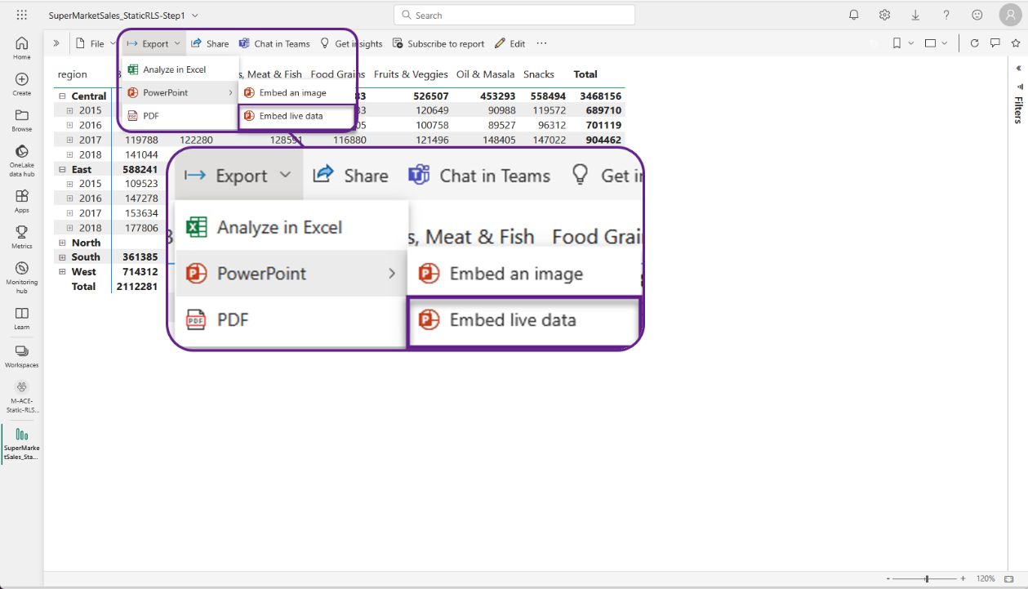

Slide 34

Few extra steps first

Slide 35
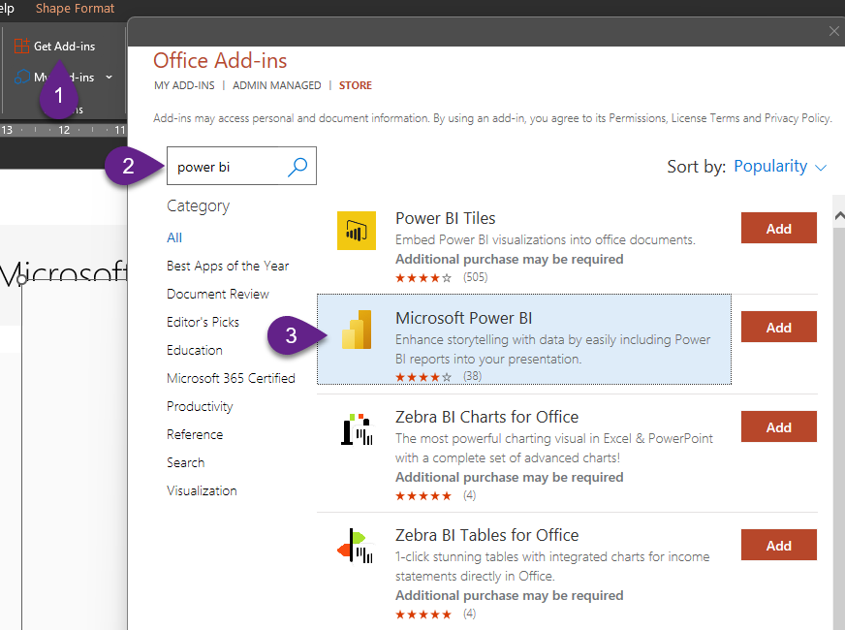

Slide 36
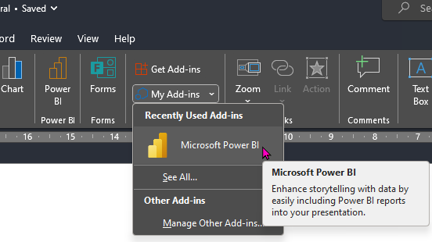

Slide 37


Slide 38
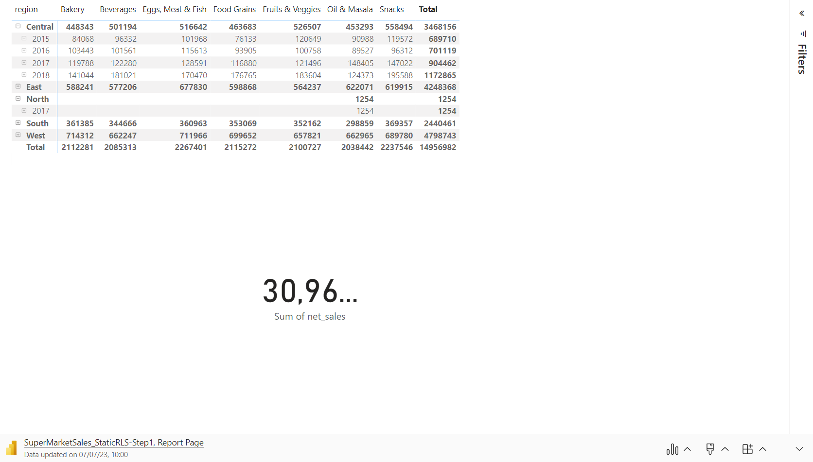

Slide 39

Hey beardy did you show them it’s a live report?
Notes:
Photo by Joshua J. Cotten on Unsplash

Slide 40
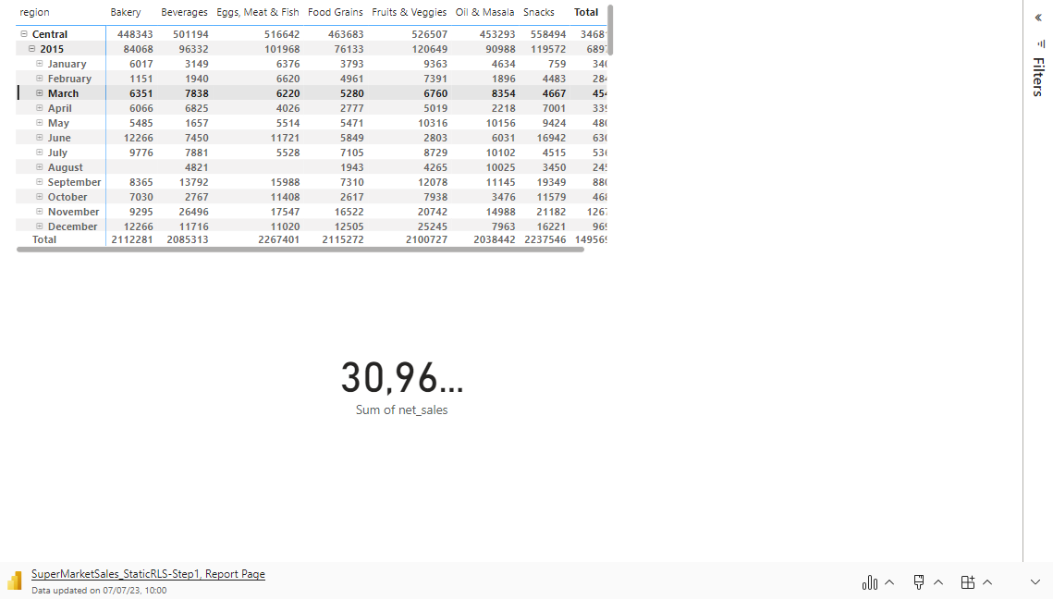

Slide 41

This Photo by Unknown Author is licensed under CC BY-NC

Slide 42
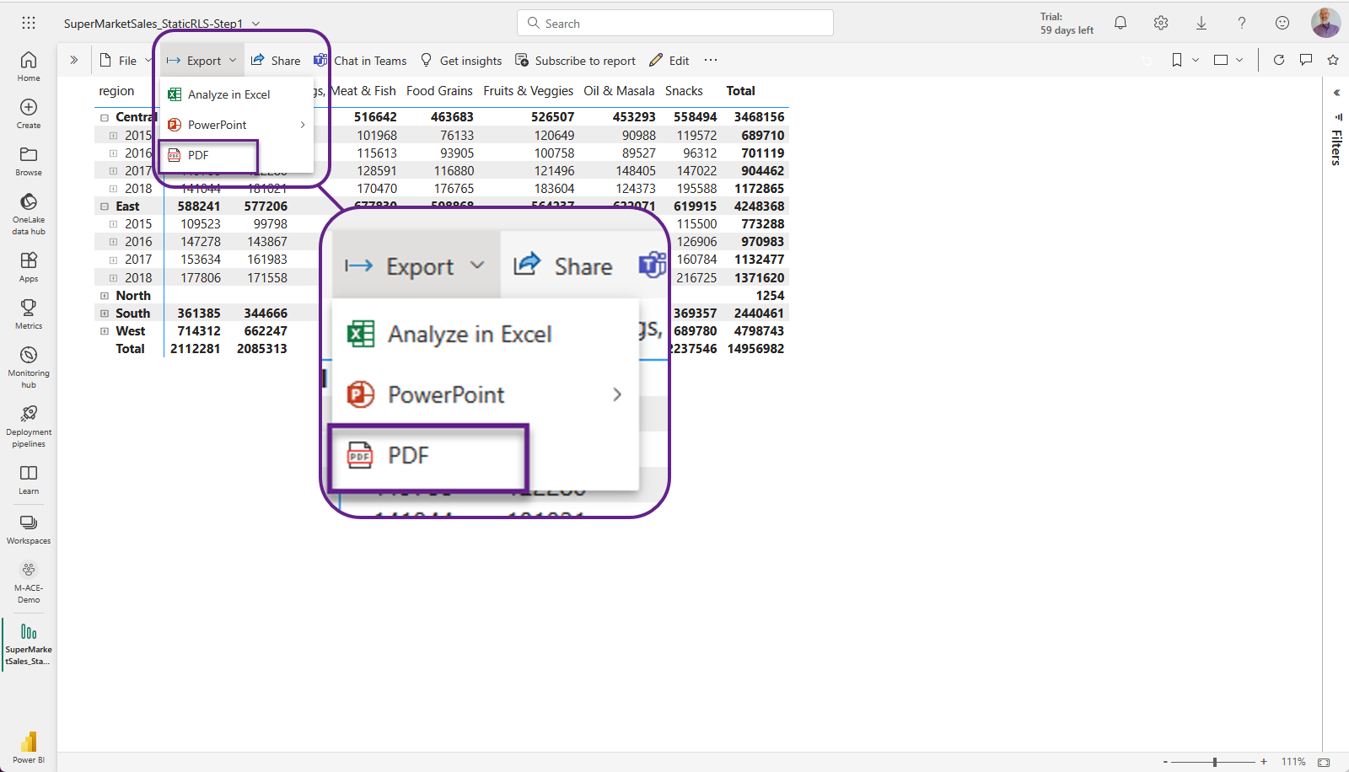

Slide 43
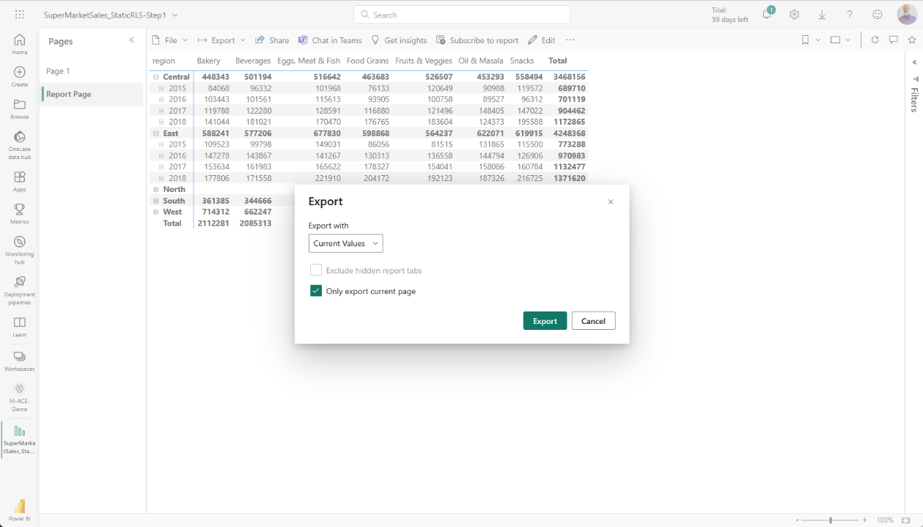

Slide 44
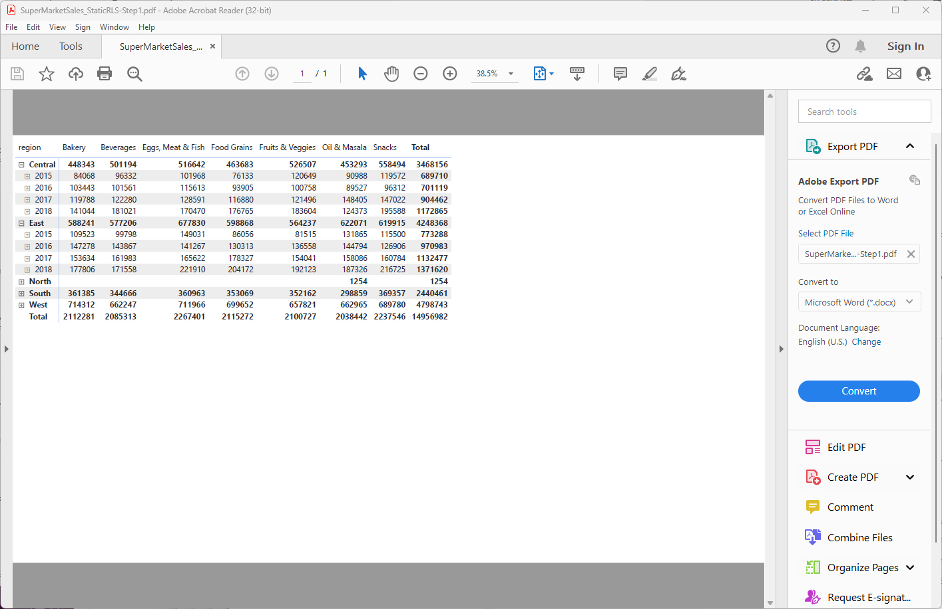

Slide 45

This Photo by Unknown Author is licensed under CC BY-SA

Slide 46
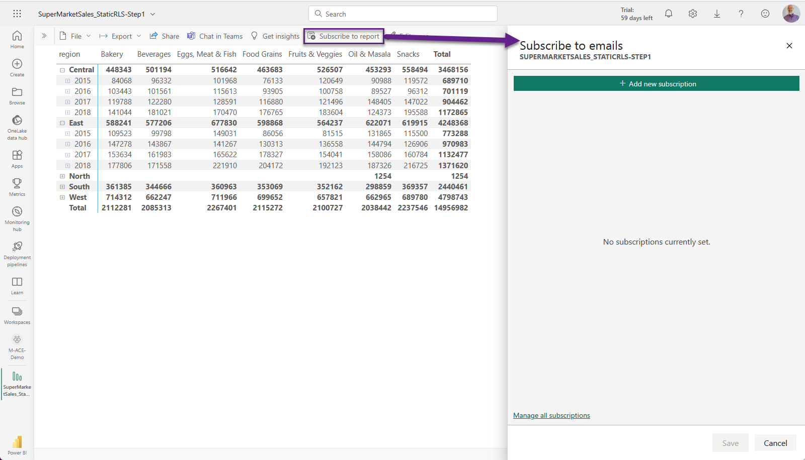

Slide 47
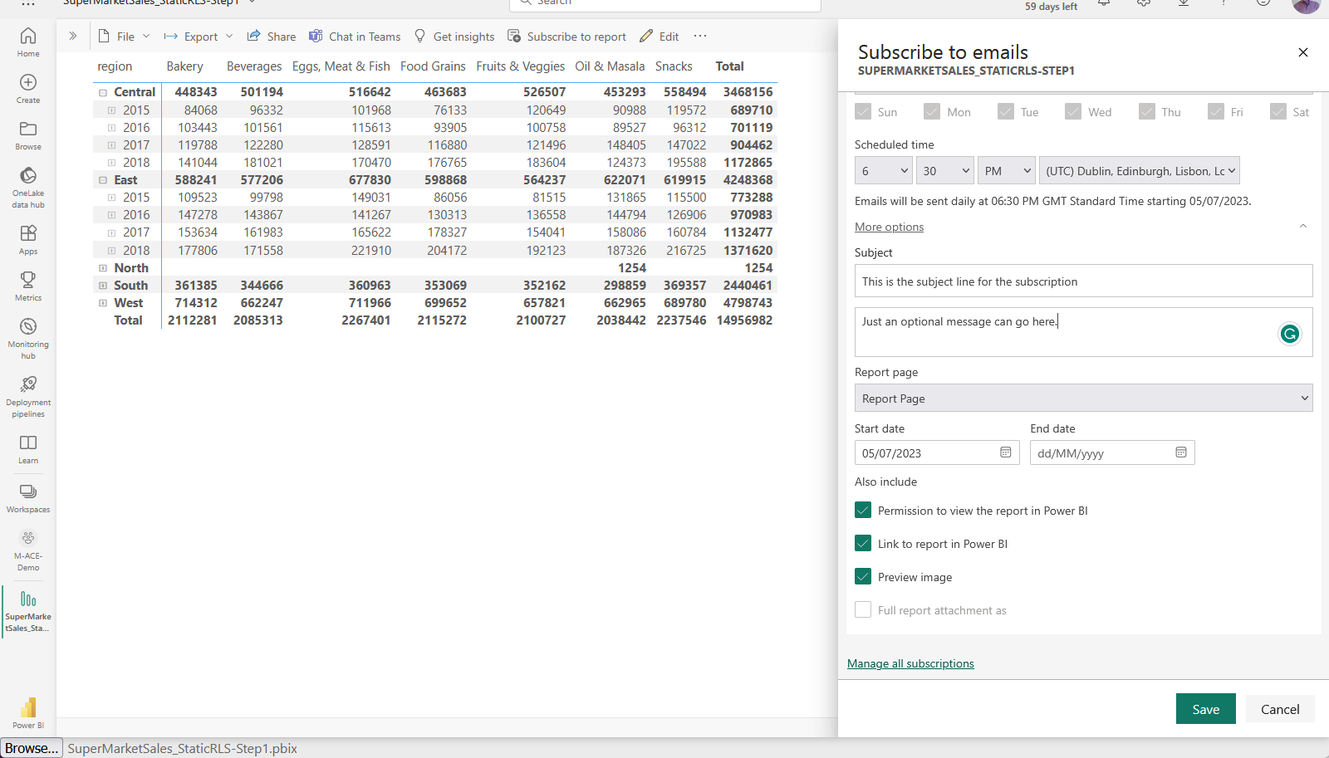

Slide 48
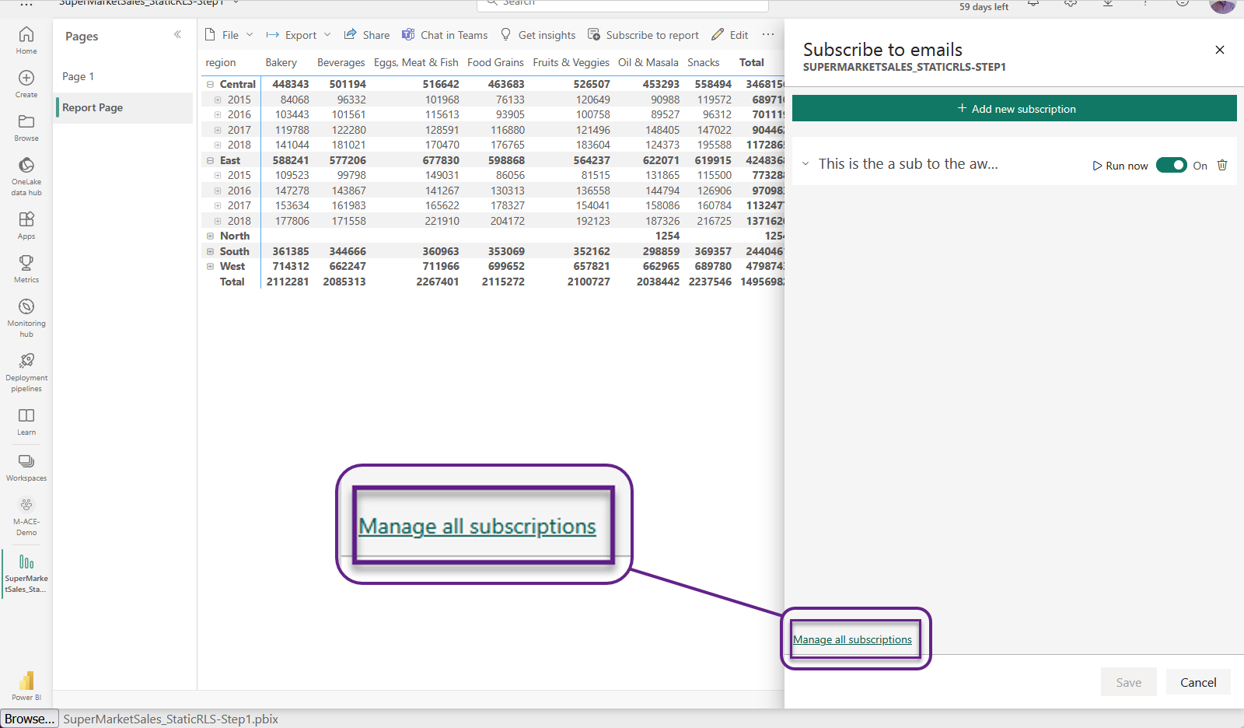

Slide 49
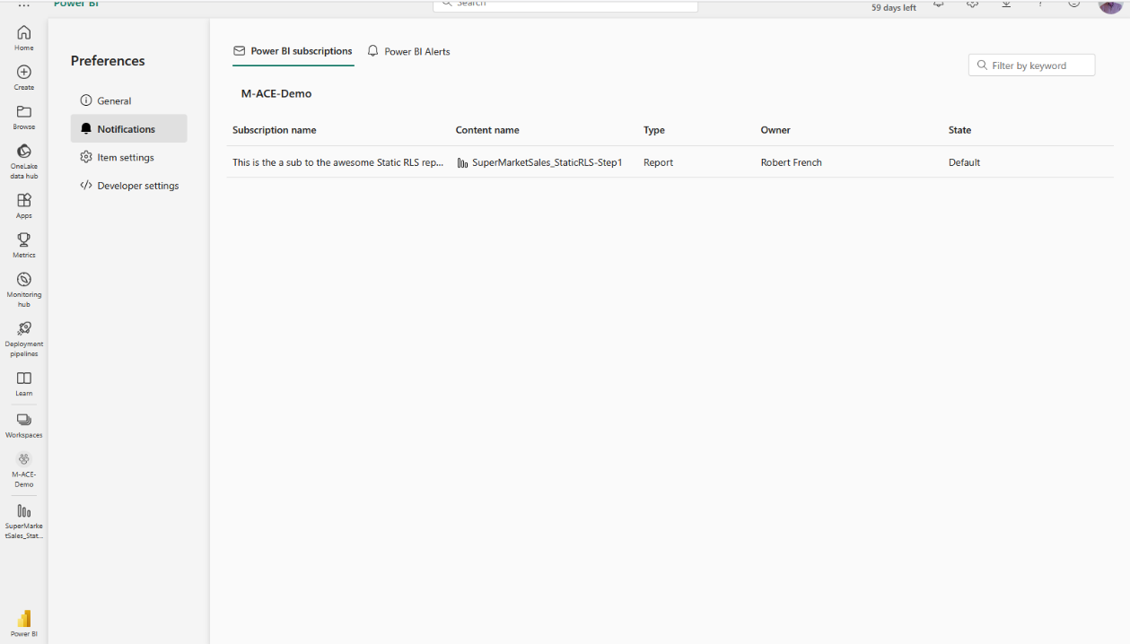

Slide 50

Power BI Data Alerts

Slide 51
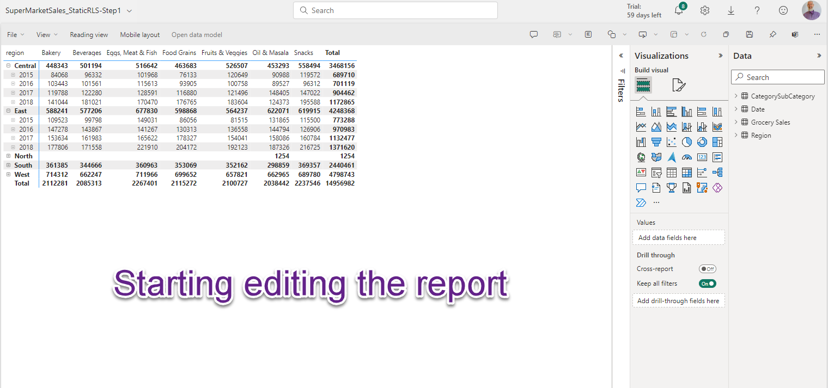

Slide 52
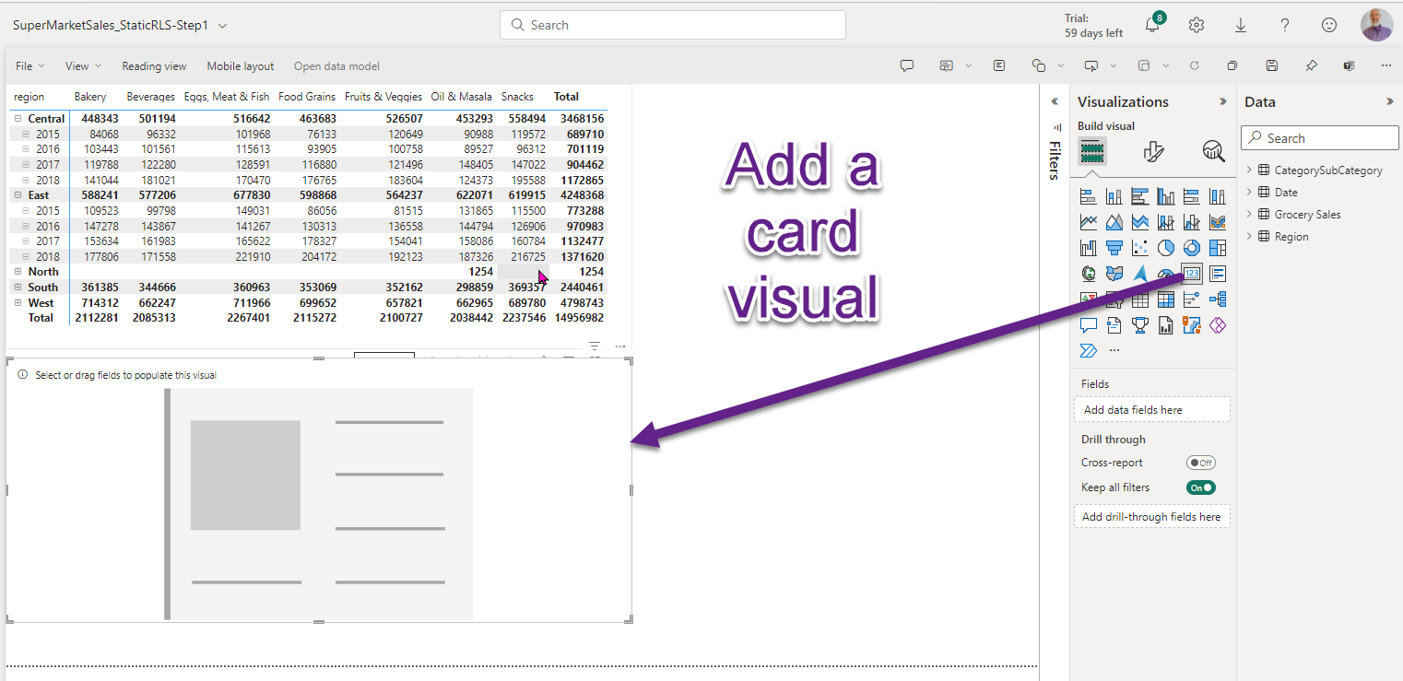

Slide 53
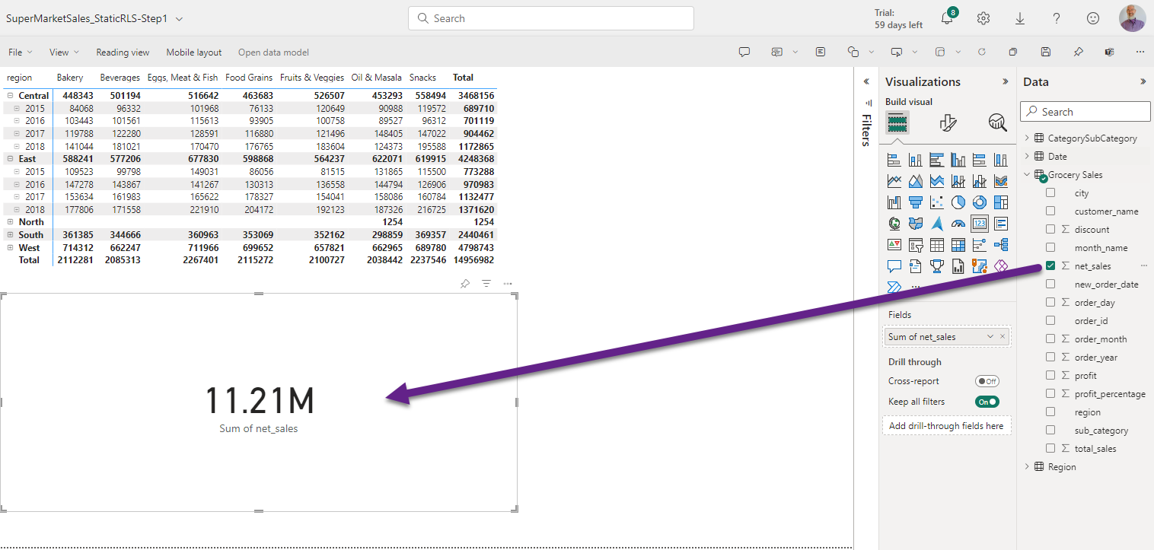

Slide 54
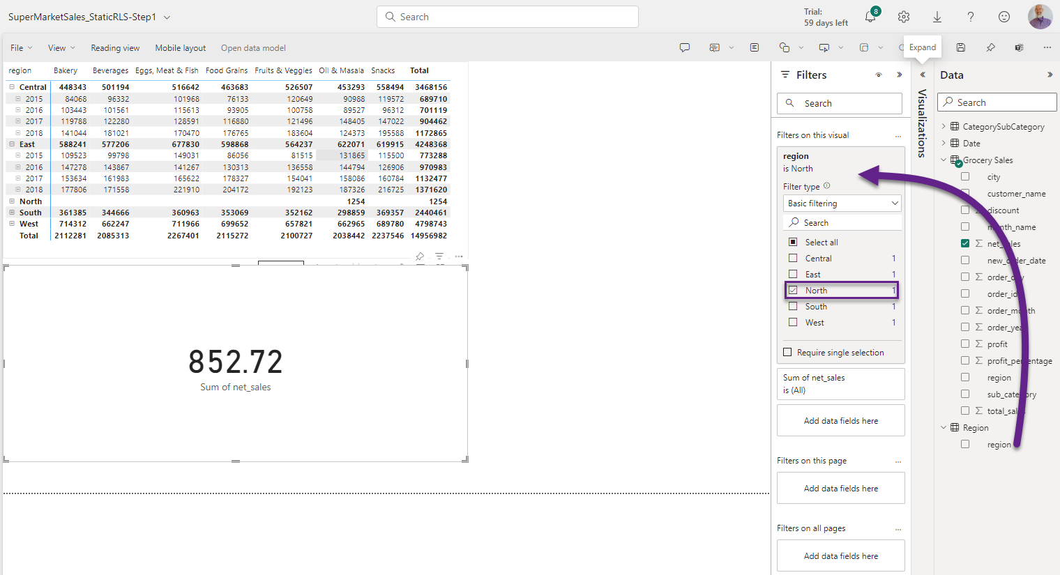

Slide 55
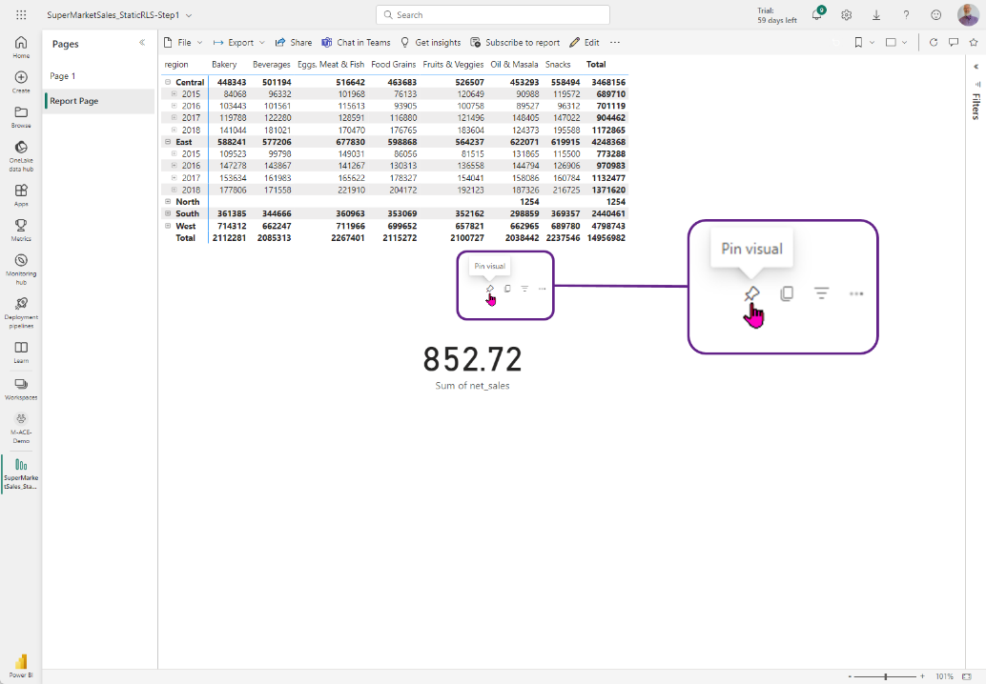

Slide 56
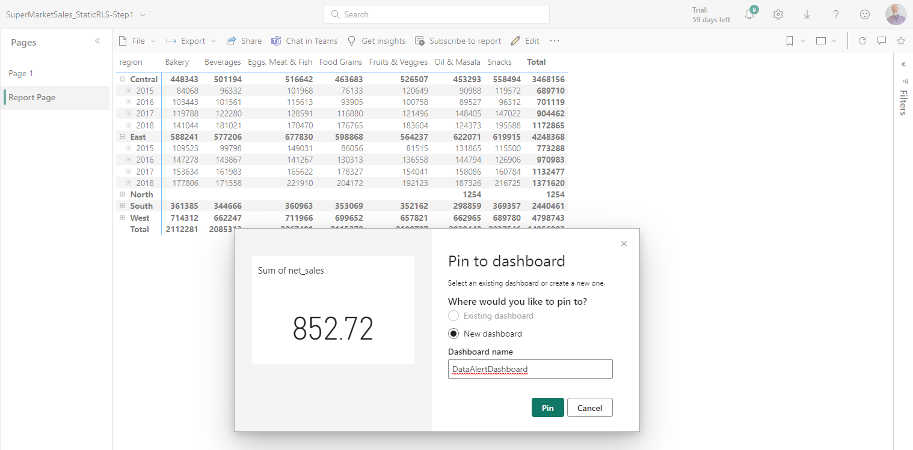

Slide 57
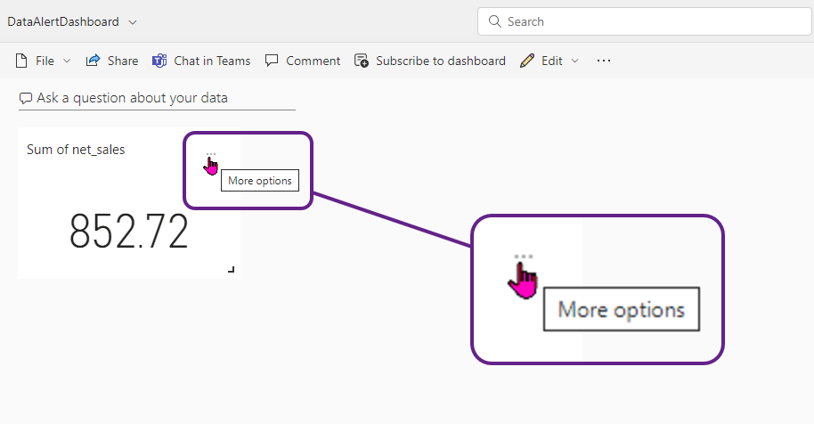

Slide 58
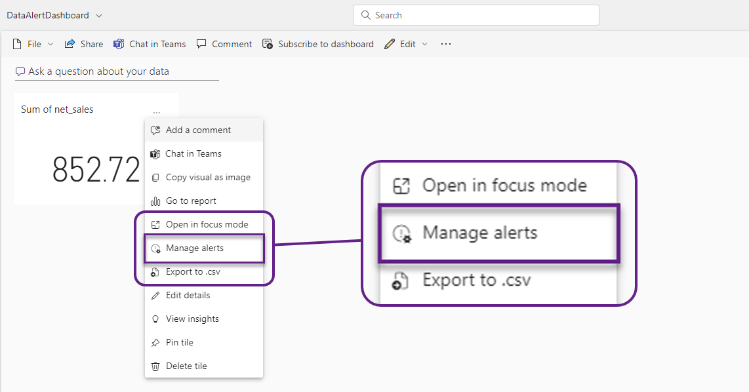

Slide 59
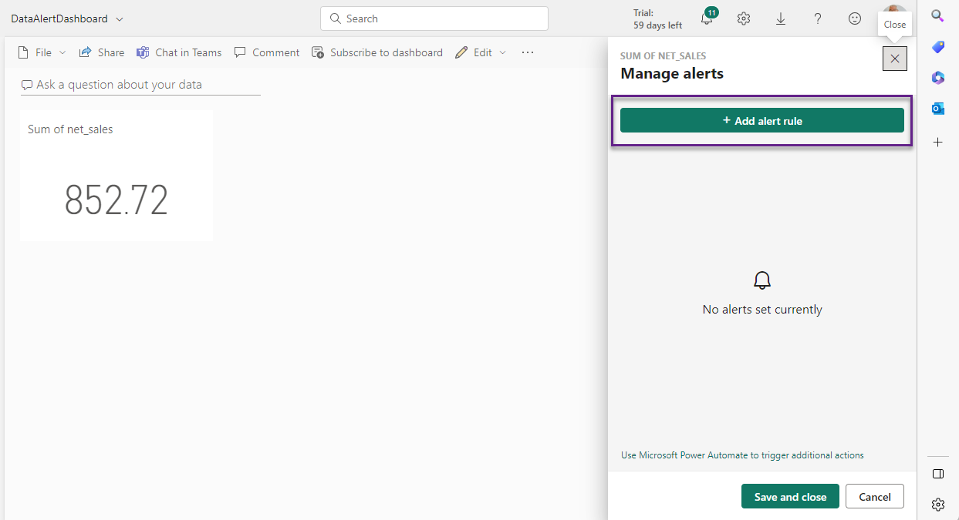

Slide 60
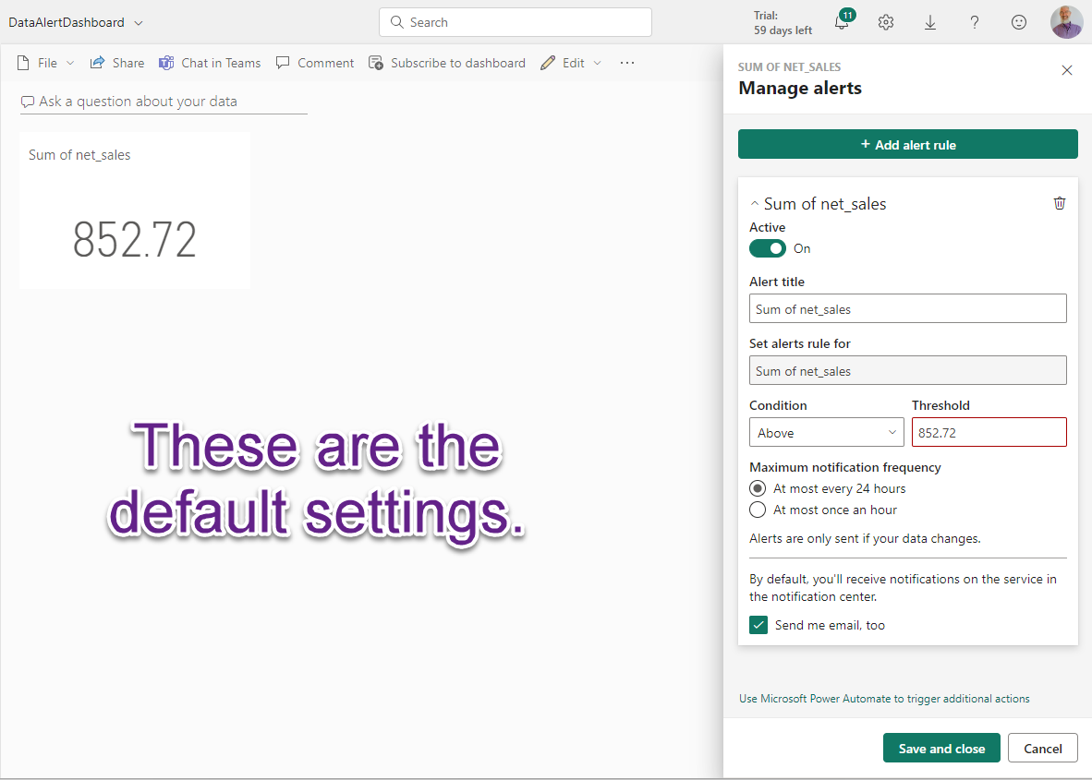

Slide 61
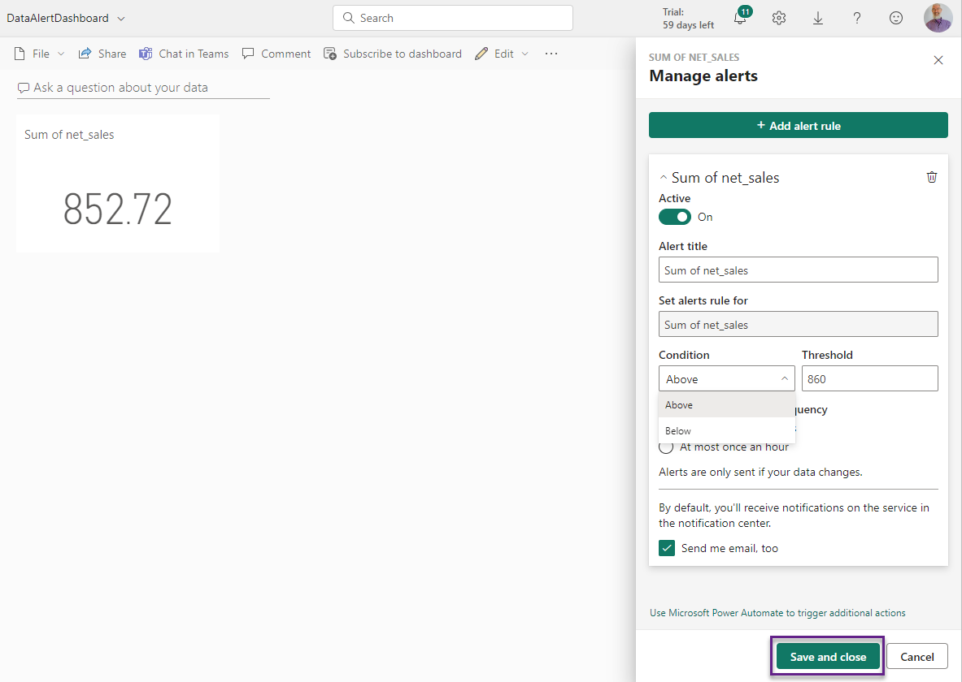

Slide 62
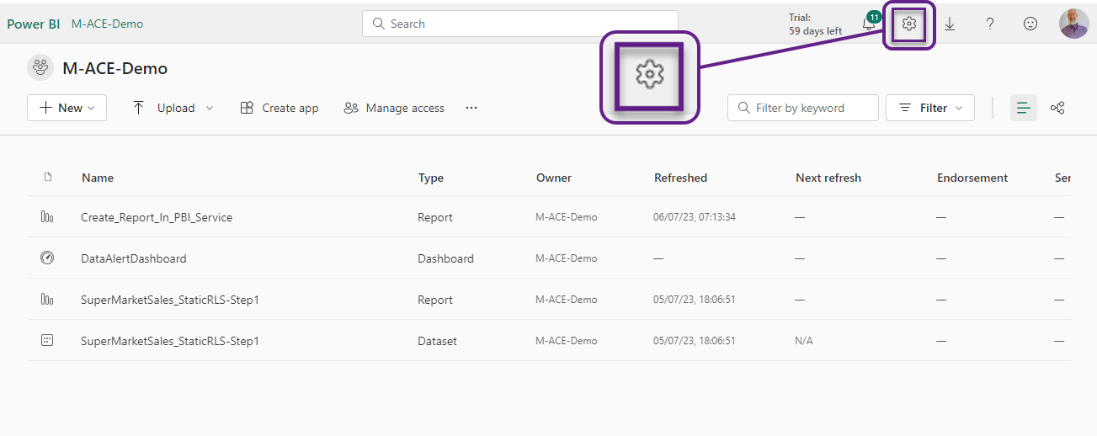

Slide 63
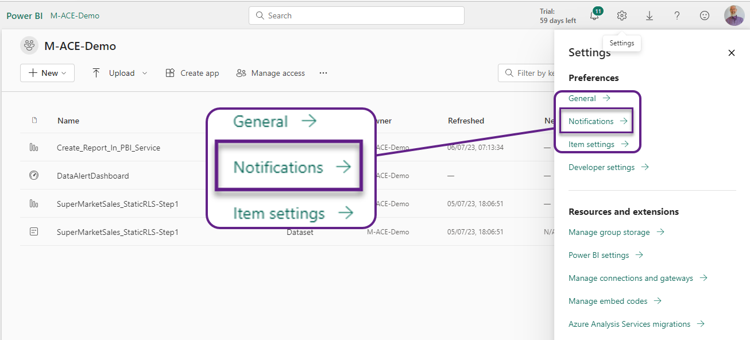

Slide 64
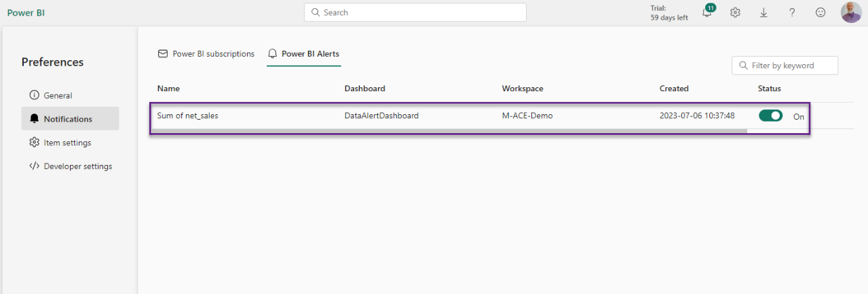

Slide 65
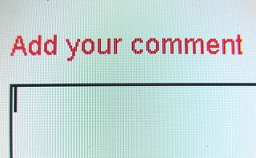
Notes:
You add your own comments

Slide 66
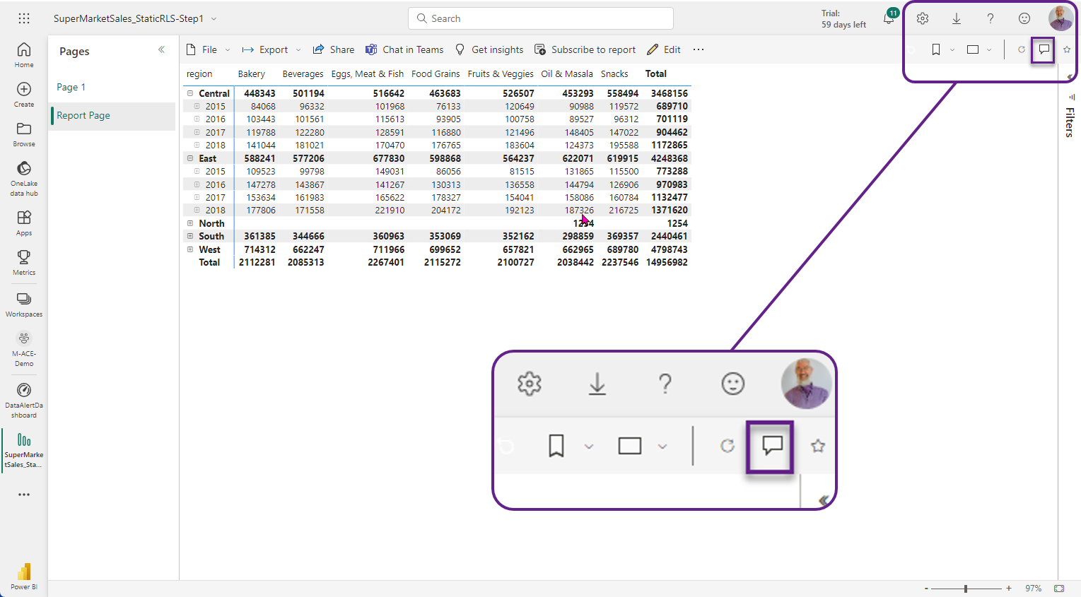

Slide 67
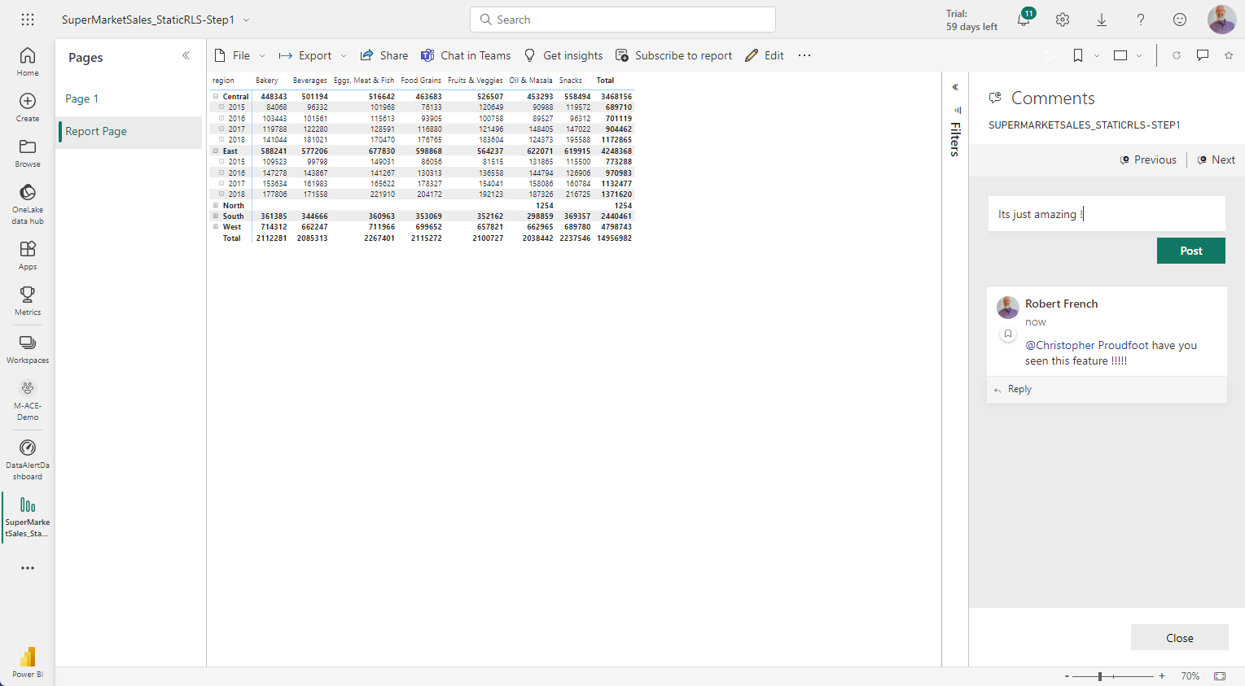

Slide 68

Microsoft Teams

Slide 69
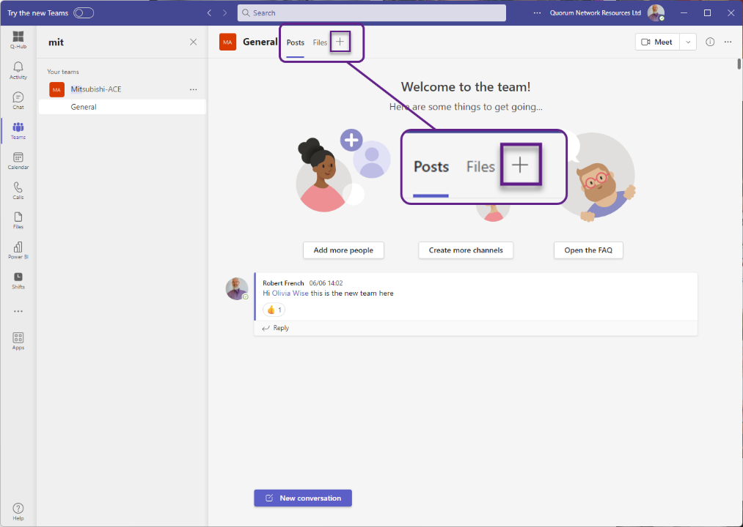

Slide 70
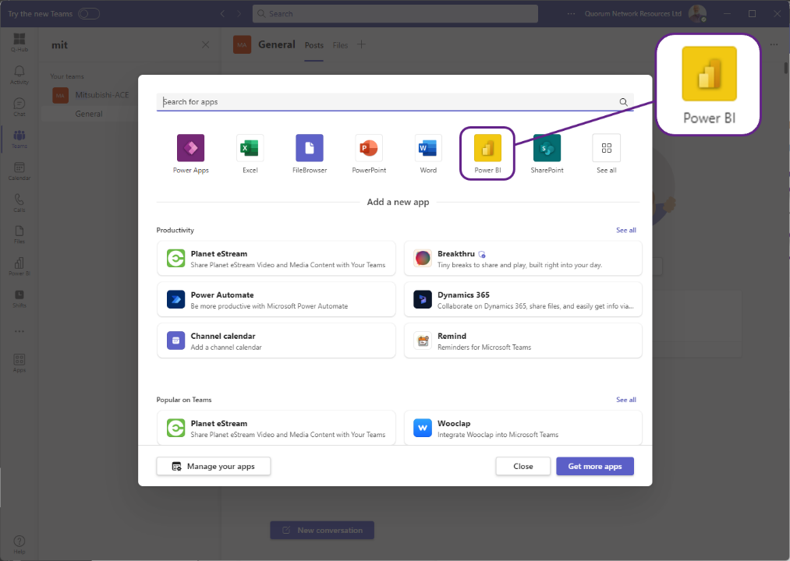

Slide 71


Slide 72


Slide 73


Slide 74


Slide 75

When they only want the data in

Slide 76


Slide 77


Slide 78


Slide 79


Slide 80


Slide 81


Slide 82


Slide 83


Slide 84


Slide 85


Slide 86


Slide 87


Slide 89

Keeping data updated
Notes:
Photo by <a href="https://unsplash.com/ja/@veri_ivanova?utm_source=unsplash&utm_medium=referral&utm_content=creditCopyText">Veri Ivanova</a> on <a href="https://unsplash.com/photos/p3Pj7jOYvnM?utm_source=unsplash&utm_medium=referral&utm_content=creditCopyText">Unsplash</a>

Slide 90
Manually for Dataflow

Slide 91


Slide 92
Manually for Dataset

Slide 93


Slide 94

Automatically for Dataflow
Notes:
Photo by Kindel Media: https://www.pexels.com/photo/top-view-modern-vacuum-cleaner-8566427/

Slide 95


Slide 96


Slide 97
Automatically for Dataset
Notes:
Photo by Kindel Media: https://www.pexels.com/photo/top-view-modern-vacuum-cleaner-8566427/

Slide 98


Slide 99


Slide 100

Notes:
Photo by <a href="https://unsplash.com/de/@darshan394?utm_source=unsplash&utm_medium=referral&utm_content=creditCopyText">Deva Darshan</a> on <a href="https://unsplash.com/photos/Jt9syHEhrPE?utm_source=unsplash&utm_medium=referral&utm_content=creditCopyText">Unsplash</a>
Just one of many ways to refresh a dataset or dataflow

